Slide 1
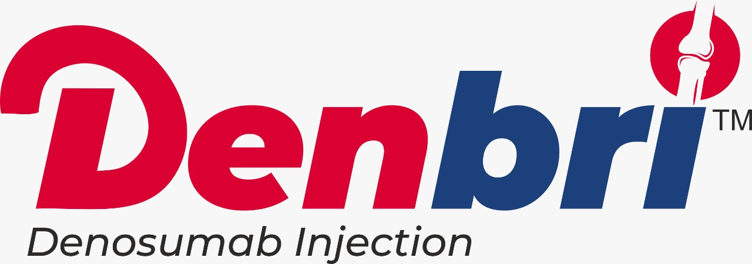

Slide 2
Outline
Basics
Bone composition
Vitamin D3 and Calcium
PTH
Calcitonin
Osteoporosis
Bone remodeling
Osteoblast
Osteoclast
Summary
Pathophysiology
Treatment of osteoporosis
Denosumab
Description
PK/PD
Dosage and Indications
Contraindications
Warning and precautions
Side effects
Place in therapy
Clinical Overview

Slide 3
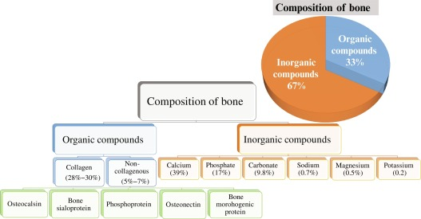
Bone composition

Slide 4
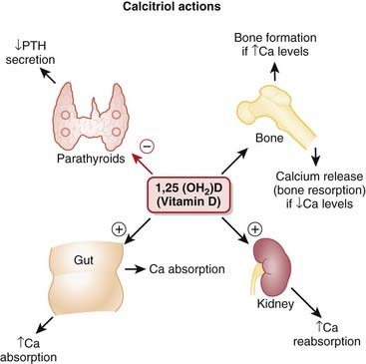
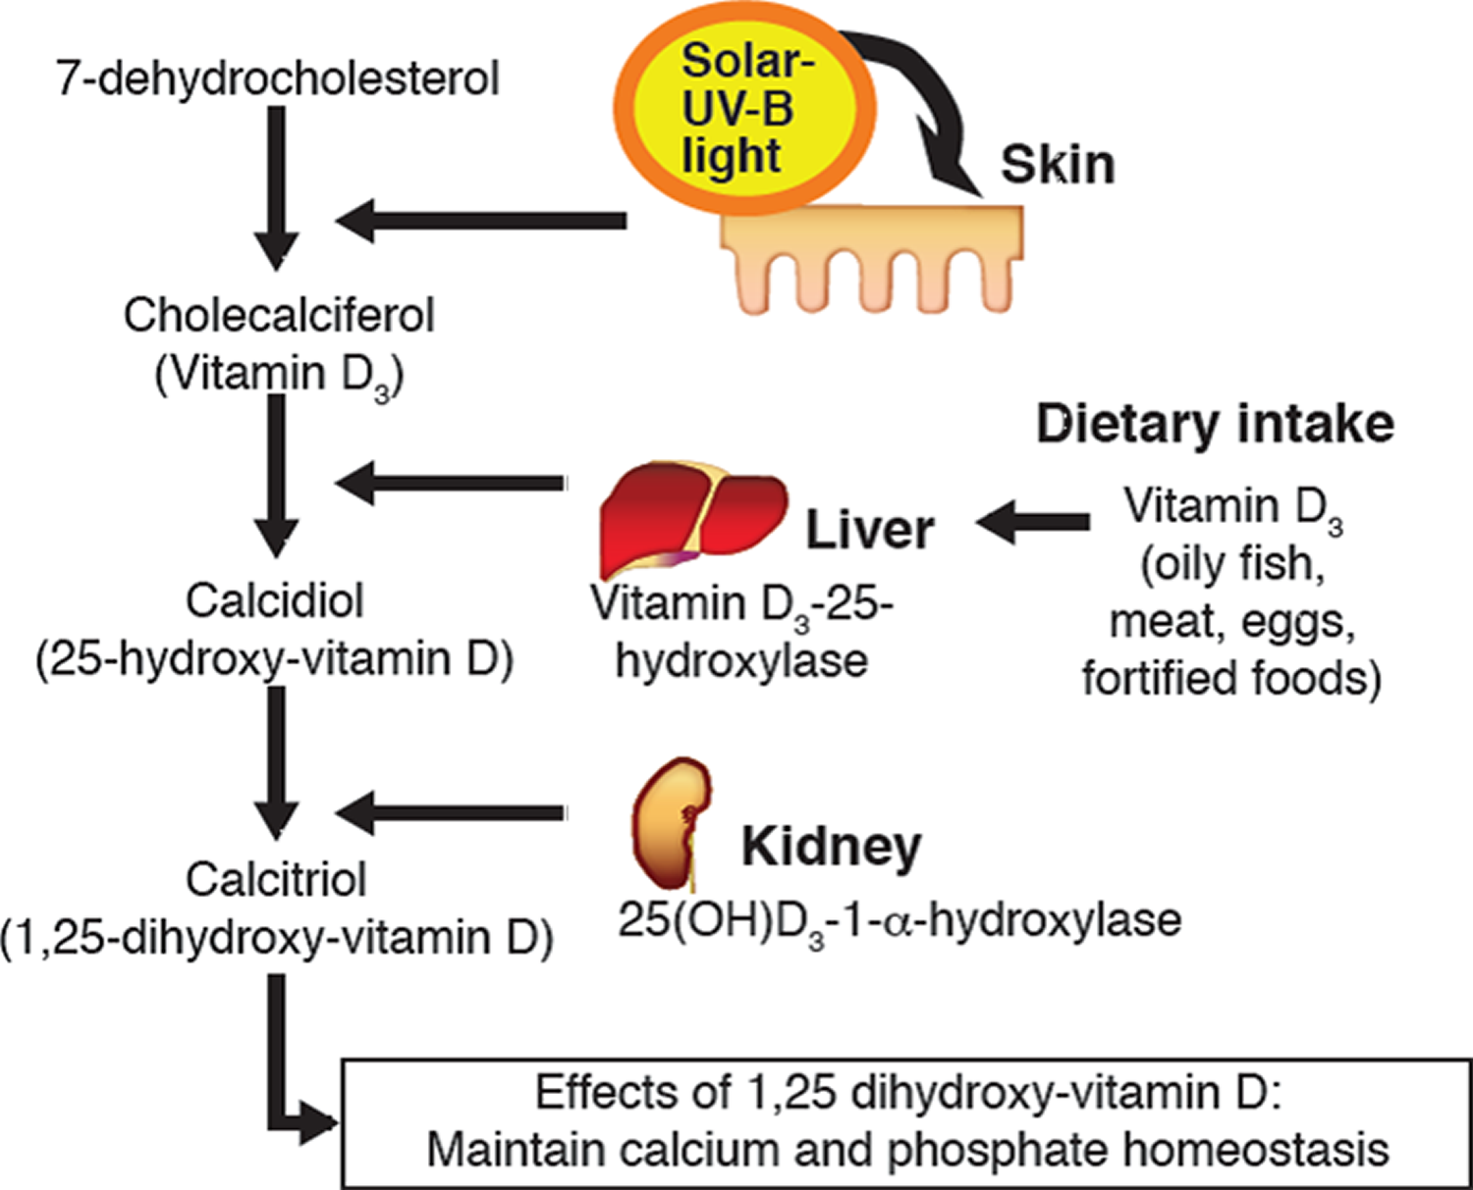
Vitamin D3

Slide 5
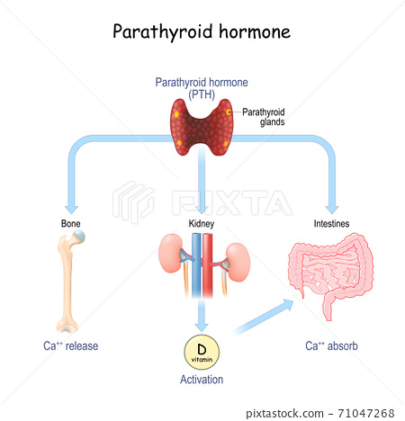
Parathyroid hormone PTH

Slide 6
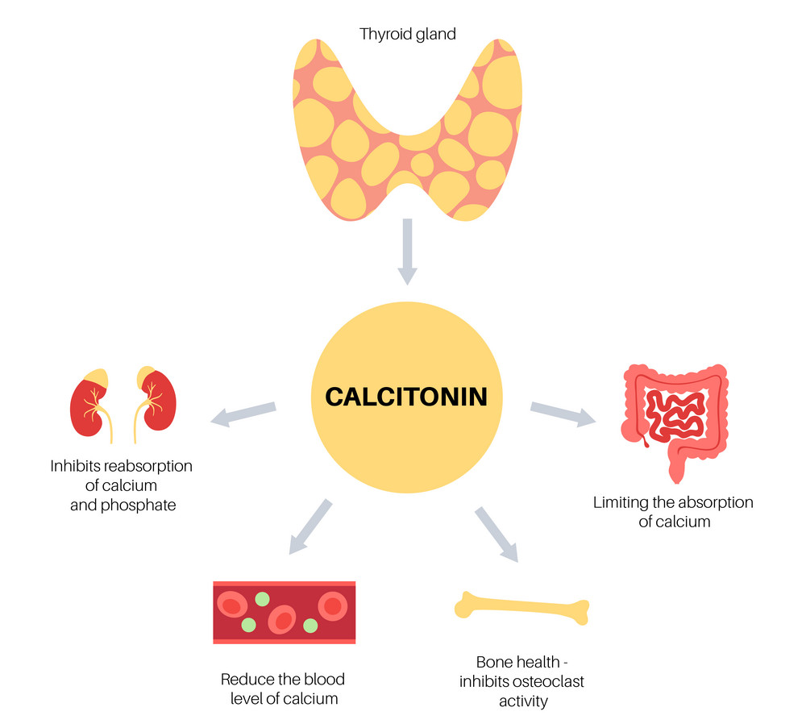

Slide 7
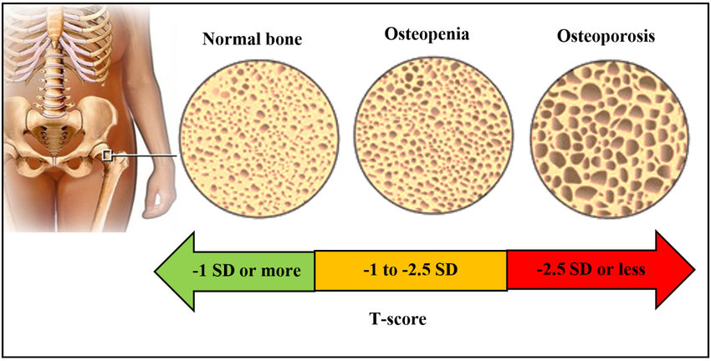
Osteoporosis

Slide 8
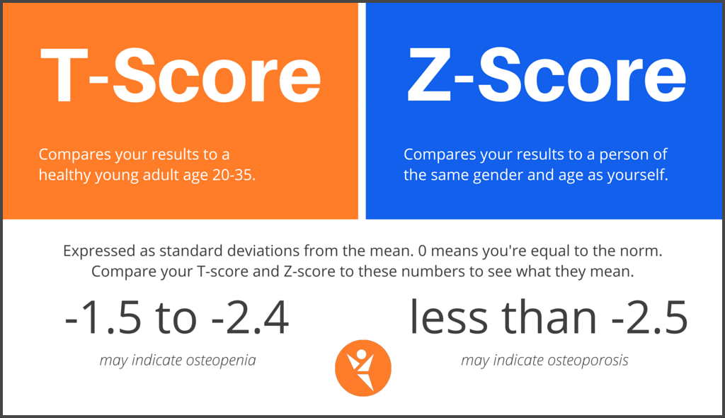
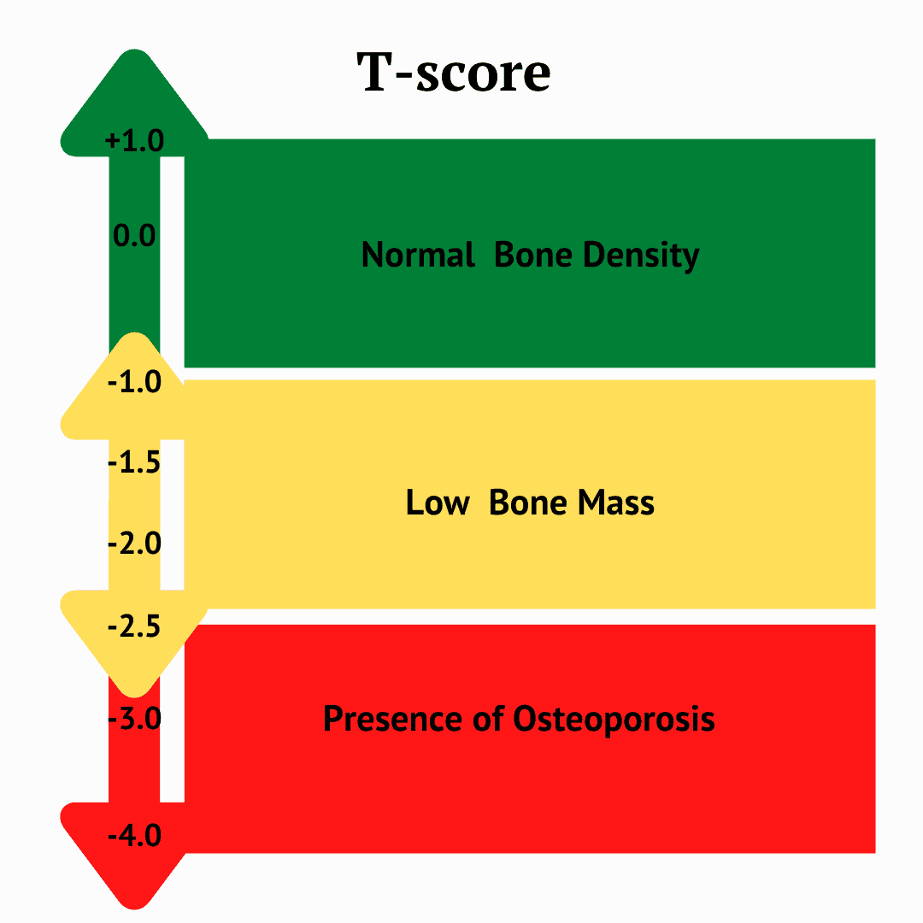
Osteoporosis

Slide 9
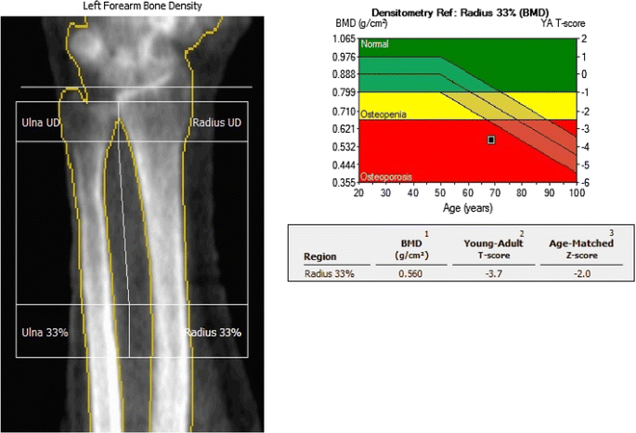
DEXA Scan dual-energy X-ray absorptiometry

Slide 10
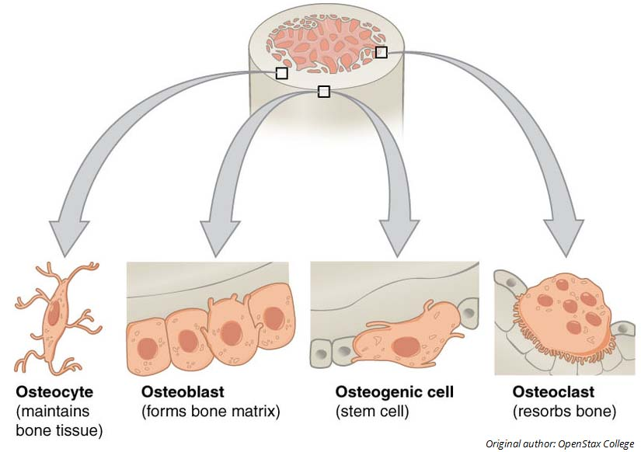

Slide 11
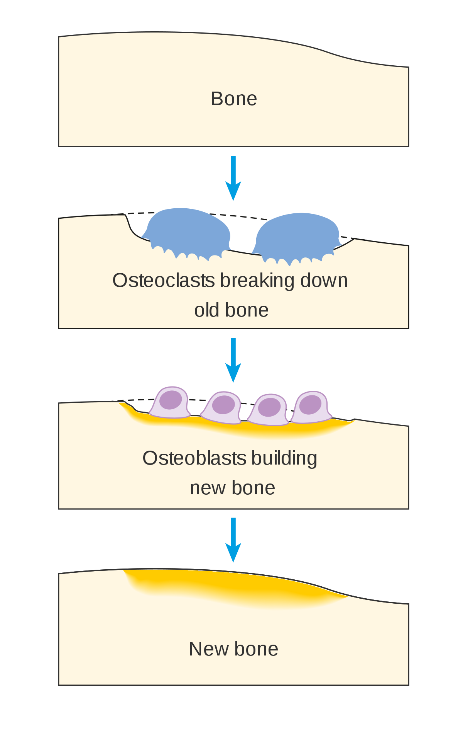
Bone remodeling
Bone remodeling involves the removal of mineralized bone by osteoclasts followed by the formation of bone matrix through the osteoblasts that subsequently become mineralized.

Slide 12
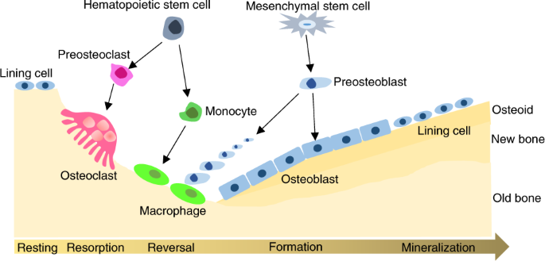
Bone remodelling

Slide 13
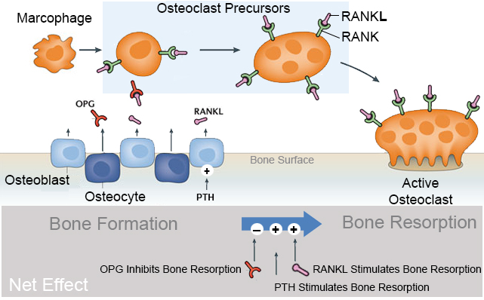
Bone remodelling
Osteoprotegerin :OPG
Receptor activator of NF-kB ligand (RANKL)
Receptor activator of NF-kB

Slide 14
Pathophysiology
Osteoporosis
Corticosteroid-Induced Osteoporosis
Transplantation Osteoporosis
Tumour Therapy-Induced Osteoporosis (Prostate cancer and breast cancer on Aromatase inhibitors )
Postmenopausal osteoporosis

Slide 15
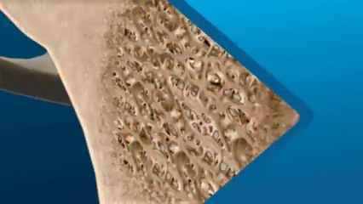
Osteoporosis

Slide 16
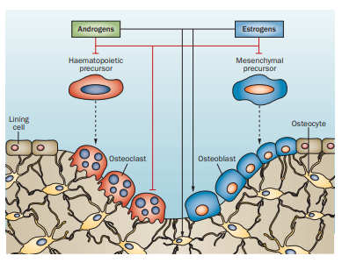
Postmenopausal osteoporosis
Red arrows : Inhibition
Back Arrow : Stimulation

Slide 17
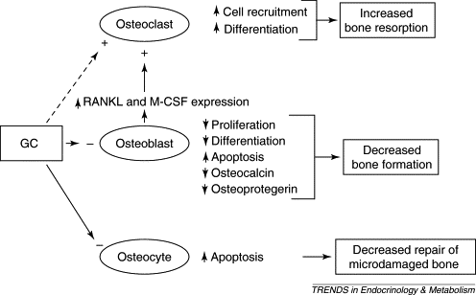
GC induced osteoporosis

Slide 18
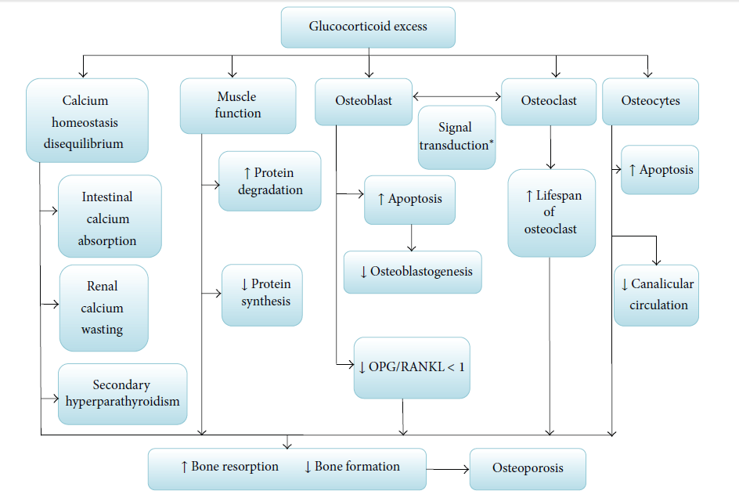
Transplantation Osteoporosis

Slide 19
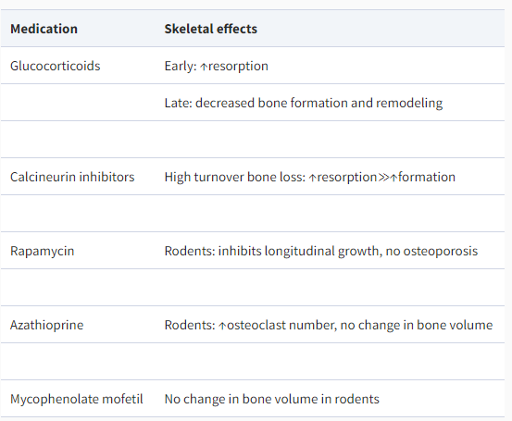
Transplantation Osteoporosis

Slide 20
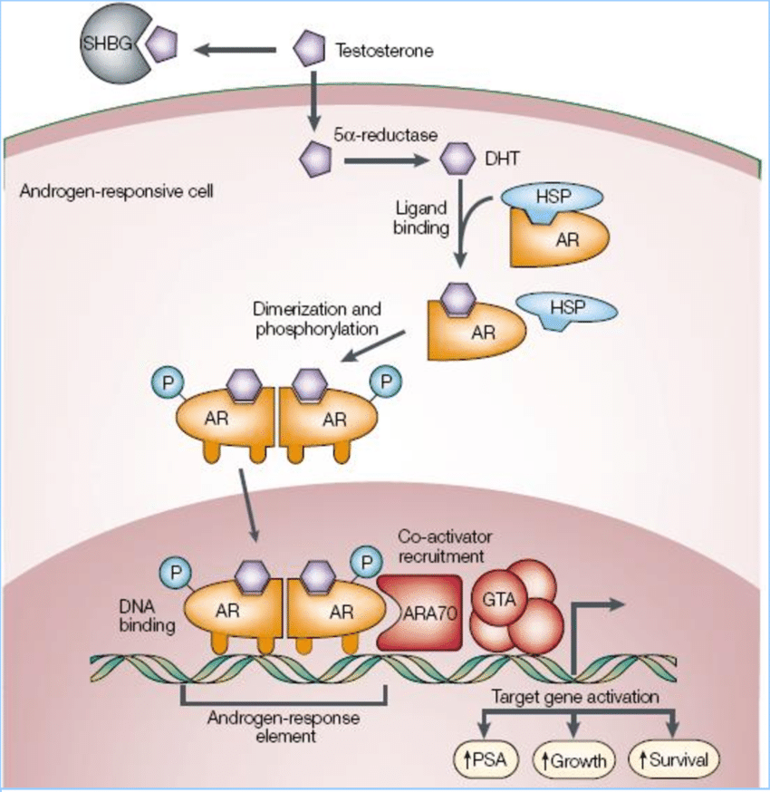
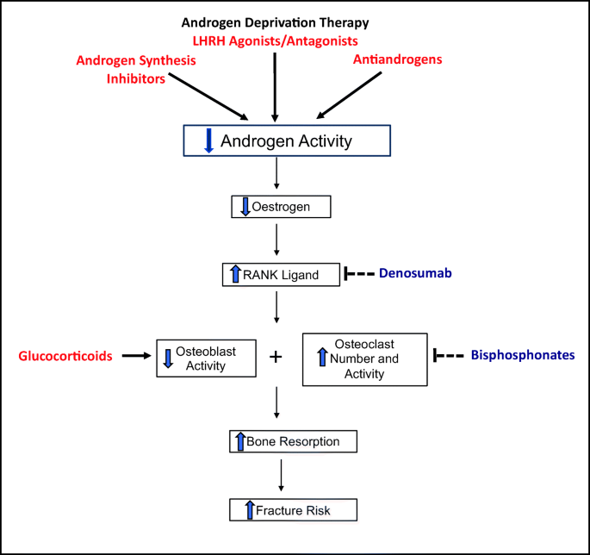
Prostate cancer and osteoporosis

Slide 21
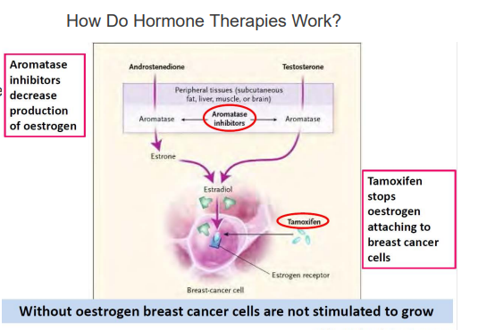
Breast cancer and Aromatase inhibitors

Slide 22
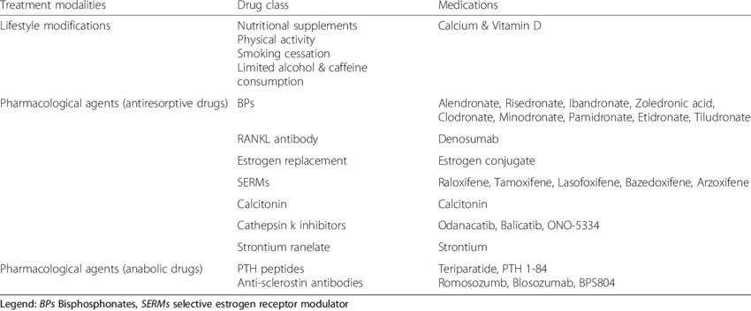
Treatment of osteoporosis

Slide 23
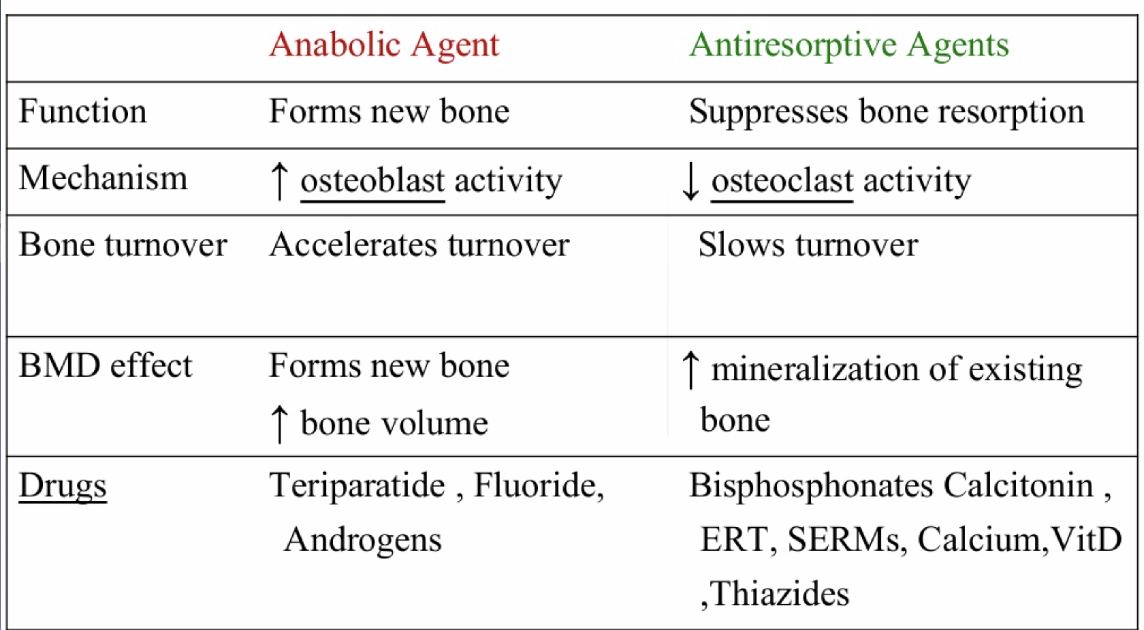

Slide 24
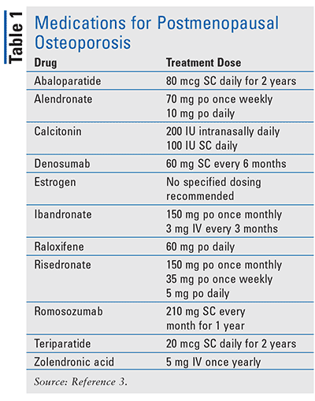
BP : Zoledronic acid
Denosumab
Teriparatide
Romosozumab

Slide 25
Denosumab
Class: Bone Resorption Inhibitors
Chemical Name: Anti-(human osteoclast differentiation factor) (human monoclonal AMG162 heavy chain), disulfide with human monoclonal AMG162 light chain immunoglobulin G2 dimer.

Slide 26
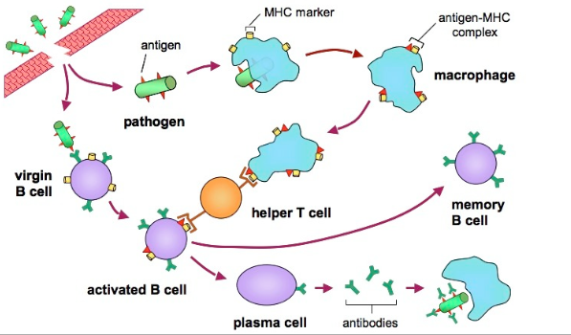
Antibodies formation in body
Antigen is presented to Macrophage by Antigen presenting cells
Macrophage activates T helper cells
T helper cell stimulate B cell
B cell produces antibody specific to antigen

Slide 27
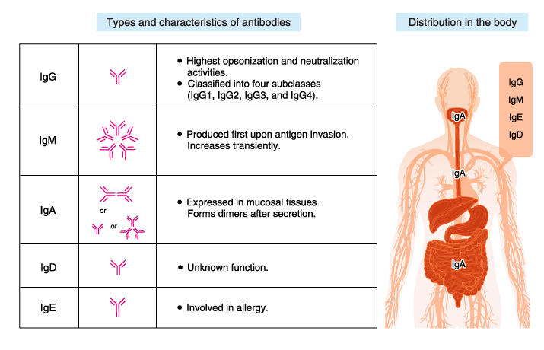
Antibody types
IgG _ most potent antibody

Slide 28
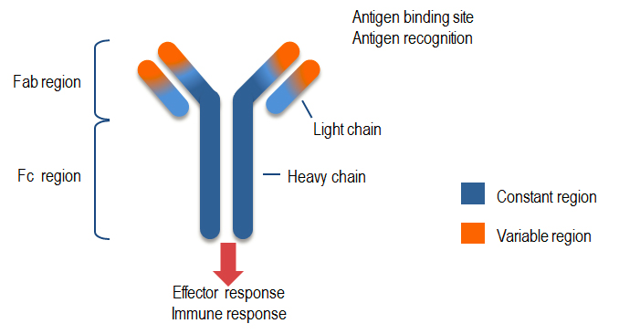
Antibody types

Slide 29
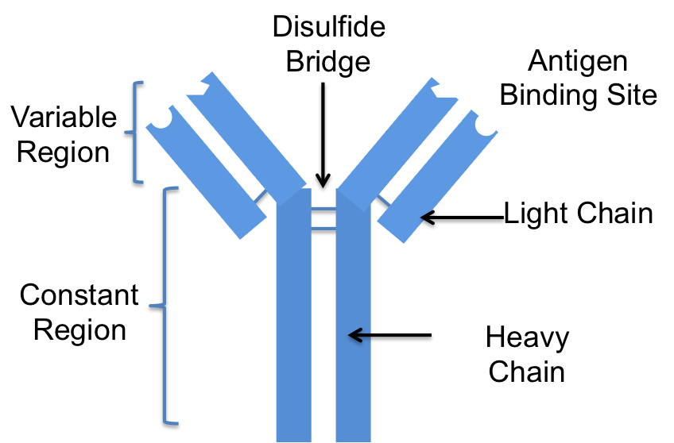
Antibodies structure
Heavy chain: α, δ, ε, γ, and μ
Light chain : lambda (λ) and kappa (κ)

Slide 30
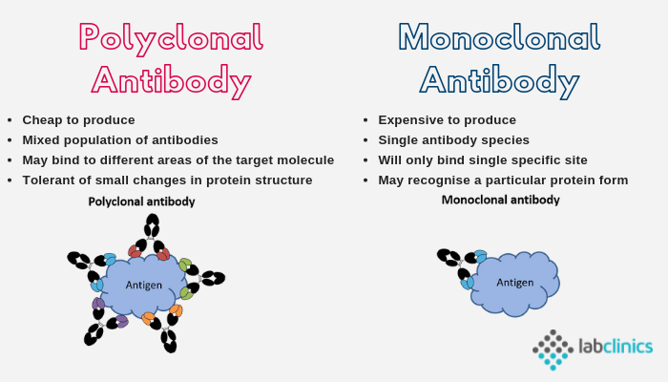
Monoclonal vs Polyclonal antibodies

Slide 31
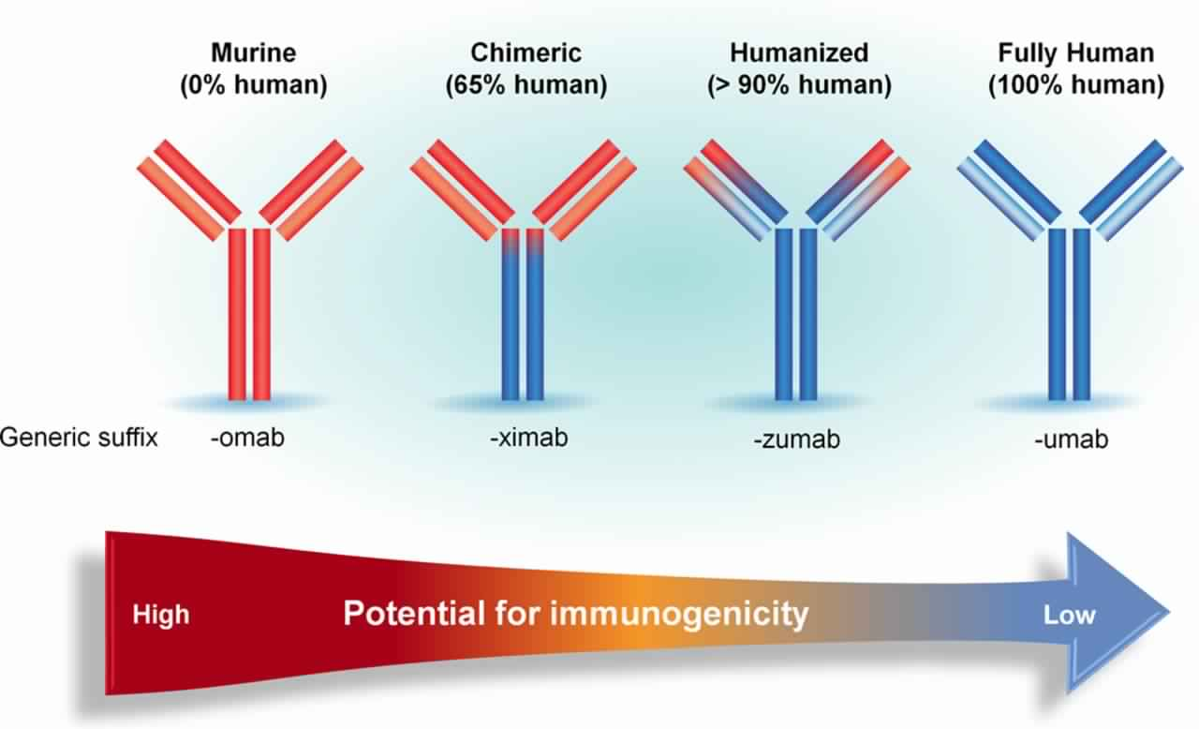
Antibodies types
Infliximab
Trastuzumab
Adalimumab

Slide 32
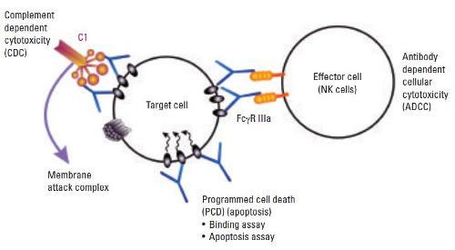
MOA of Mab
Neutralization: blocks the function of target
ADCC: Attracts macrophage and natural killer cell _ kills the Mab surrounded cell
CDS_ attracts the protein _ causes lysis of target cells
Drug delivery carrier

Slide 33
Key differences between and bisphosphonates and denosumab
Feature | Bisphosphonates | Denosumab
Molecular target Structure Effect on osteoclast The onset of action Nephrotoxicity | Cellular metabolic enzymes; for the nitrogen-containing bisphosphonates, the key target is Farnesyl pyrophosphate (FPPS) an enzyme needed for modification (prenylation) of protein Small-molecule drugs Induce apoptosis; 6 to 12 months * Released bisphosphonates are cleared by the kidney Intravenous bisphosphonates have a higher risk of side effects than oral bisphosphonates, including nephrotoxicity of various sorts. | Binds with high affinity and specificity to circulating RANKL Monoclonal antibody Inhibits osteoclast formation, function, and survival rapid onset of action Within 3 days# Cleared by the reticuloendothelial system with a half-life of approx. 26 days Denosumab does not cause nephrotoxicity.
Int J Clin Pract, December 2012, 66, 12, 1139–1146

Slide 34
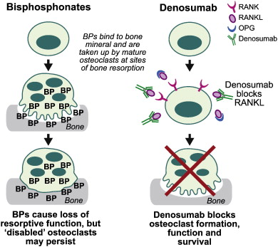
MOA for denosumab and bisphosphonates
Denosumab is a more potent bone resorption inhibitor than BP.
When denosumab medication is stopped, the suppression of bone turnover is quick and completely reversed.

Slide 35
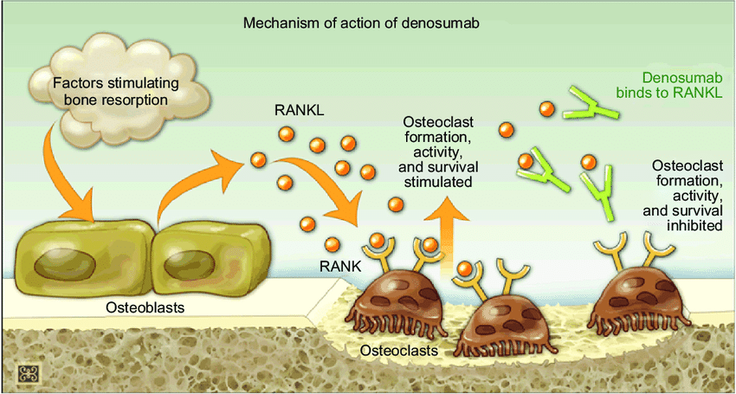
Denosumab is a monoclonal antibody that is fully human and was approved by the FDA as the first RANKL inhibitor.
RANK is activated by the ligand RANKL, which is present on the cell surface of osteoblasts.
By activating RANK, RANKL promotes the development of pre-osteoclasts into active osteoclasts.
Denosumab binds to RANKL and inhibits it, inhibiting the formation of osteoclasts.
This reaction protects the bone from resorption by mimicking the natural activity of OPG.

Slide 36
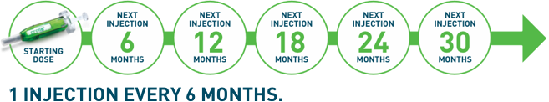
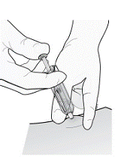
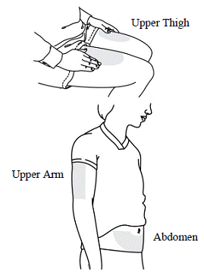
Denosumab dose and administration
TREATMENT OF PATIENTS WITH OSTEOPOROSIS AT HIGH RISK FOR FRACTURE
Approved Indication:
Treatment Of Postmenopausal Women With Osteoporosis At High Risk For Fracture.
Treatment To Increase Bone Mass In Men With Osteoporosis
Treatment Of Glucocorticoid-Induced Osteoporosis
Treatment Of Bone Loss In Men Receiving Androgen Deprivation Therapy For Prostate Cancer
Treatment Of Bone Loss In Women Receiving Adjuvant Aromatase Inhibitor Therapy For Breast Cancer
Dosage and Administration:
Information Essential To Safe Dosing Or Administration
Pregnancy must be ruled out prior to administration of Denosumab.
Perform pregnancy testing in all females of reproductive potential prior to administration of Denosumab.
The recommended dose of Denosumab.
60 mg administered as a single S.C injection once every 6 months.
Administer Denosumab via S.C injection in the upper arm, the upper thigh, or the abdomen.
All patients should receive calcium 1000 mg daily and at least 400 IU vitamin D daily
Choose an injection site.
The recommended injection sites for Denosumab include the upper arm OR the upper thigh OR the abdomen.
Contraindications:
Hypocalcemia

Slide 37
Denosumab dose and Administration
Treatment of patients with osteoporosis at high risk for fracture
Warnings and precaution
Hypocalcemia: Must be corrected before initiating Denosumab It May worsen especially in patients with renal impairment. Adequately supplement patients with calcium and vitamin D
Serious infections including skin infections: Advise patients to seek prompt medical attention if they develop signs or symptoms of infection, including cellulitis
Dermatologic reactions: Dermatitis, rashes, and eczema have been reported. Consider discontinuing Denosumab if severe symptoms develop
Osteonecrosis of the jaw: Has been reported with Denosumab Monitor for symptoms
Suppression of bone turnover: Significant suppression has been demonstrated. Monitor for consequences of bone over suppression
Adverse reactions
The Most common adverse reactions (> 5% and more common): back pain, pain in extremity, hypercholesterolemia, musculoskeletal pain, and cystitis. Pancreatitis may occur
Use in specific populations
Pregnancy: Based on animal data, may cause fetal harm.
Nursing mothers: May impair mammary gland development and lactation. Discontinue drug or nursing
Pediatric patients: Safety and efficacy not established
Renal impairment: No dose adjustment is necessary in patients with renal impairment. Patients with creatinine clearance < 30 mL/min or receiving dialysis are at risk for hypocalcemia. Supplement with calcium and vitamin D and consider monitoring serum calcium
Overdosage.
There is no experience with overdosage with Denosumab .

Slide 38
Clinical Overview
Osteoporosis

Slide 39
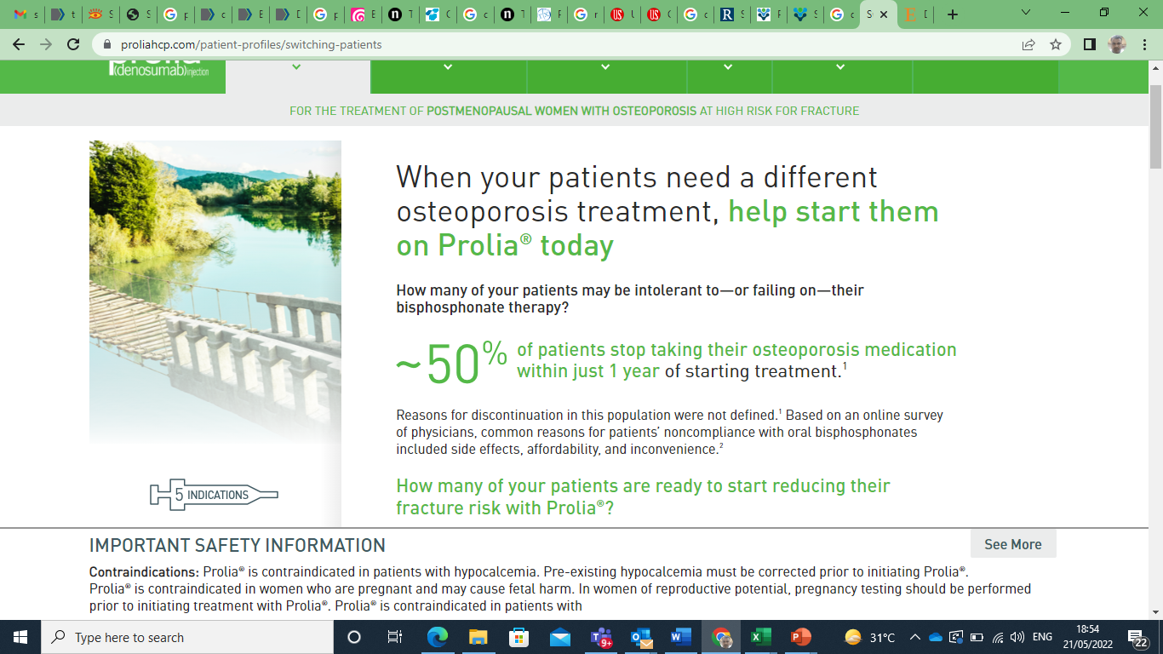
Curr Rheumatol Rep. 2008;10:118-122. 2

Slide 40
Clinical overview
Denosumab vs Bisphosphonate
Meta-analysis (J Clin Endocrinol Metab, May 2019)
10 eligible trials including 5361 participants
24 months
Vs Bisph , 49% less risk of fracture
Teriparatide + Denosumab
DATA study (Lancet. 2013 )
Combined teriparatide and denosumab increased BMD more than either agent alone
Teriparatide to Denosumab
DATA switch study (Lancet 2015)
Postmenopausal osteoporotic women switching from teriparatide to denosumab, bone mineral density continued to increase, whereas switching from denosumab to teriparatide results in progressive or transient bone loss

Slide 41
Clinical overview
Denosumab vs Other therapies in Post menopause (J Clin Endocrinol Metab, May 2019, 104(5):1623–1630)
107 trials (193,987 postmenopausal women; mean age, 66 years
 | Hip fracture risk reduction | Non vertebral | Vertebral
Denosumab | -44% | -20% | -68%
Zoledronic acid | -40% | -21% | -62%
Romosozumab | -56% | -49% | - 67%
Teriparatide, abaloparatide, denosumab, romosozumab, and most bisphosphonates appear to have the highest efficacy
J Clin Endocrinol Metab, May 2019, 104(5):1623–1630

Slide 42
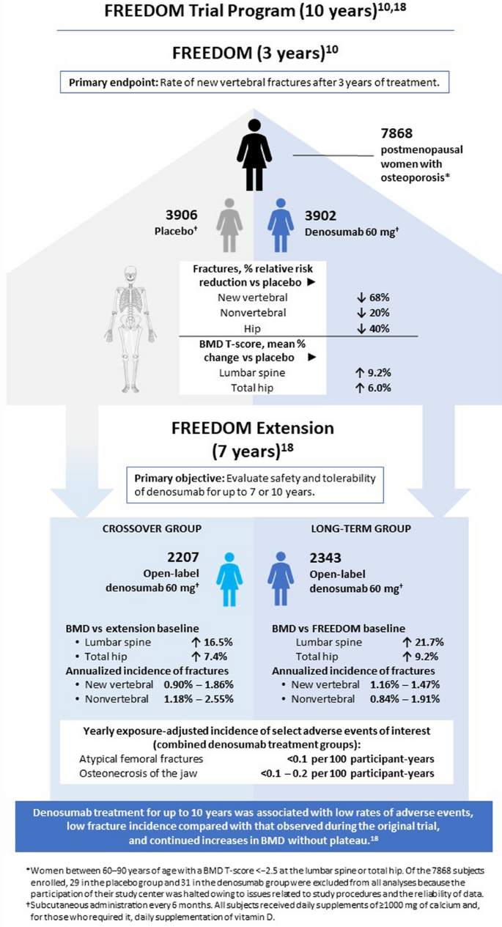
Clinical overview
FREEDOM Study

Slide 43
Clinical overview
Glucocorticoid induced (J Clin Endocrinol Metab. 2020 Jan 1;105(1):dgz023)
19 unique trials involving 4328 patients receiving GCs
Teriparatide (risk ratio [RR] 0.11, 95% confidence interval [CI] 0.03-0.47), denosumab (RR 0.21, 95% CI 0.09-0.49), and risedronate (RR 0.33, 95% CI 0.19-0.58) reduced the risk of GI vertebral fractures
In terms of clinical efficacy and safety, second-line teriparatide and denosumab pose a challenge to first-line oral bisphosphonates for prevention of GI fractures

Slide 44
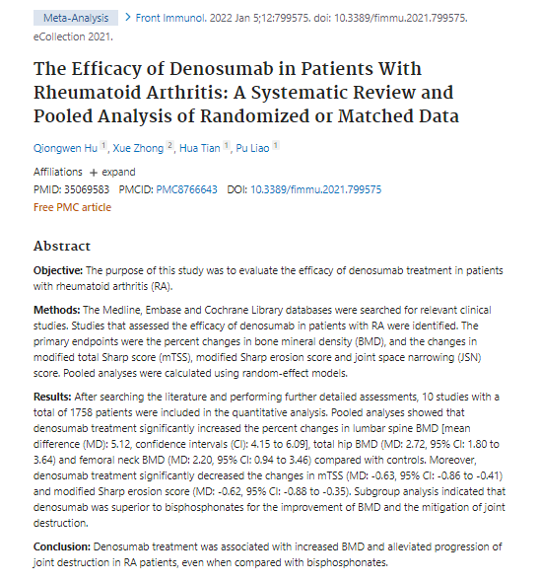
10 studies with a total of 1758 patients
Denosumab treatment was associated with increased BMD and alleviated progression of joint destruction in RA patients, even when compared with bisphosphonates.

Slide 45
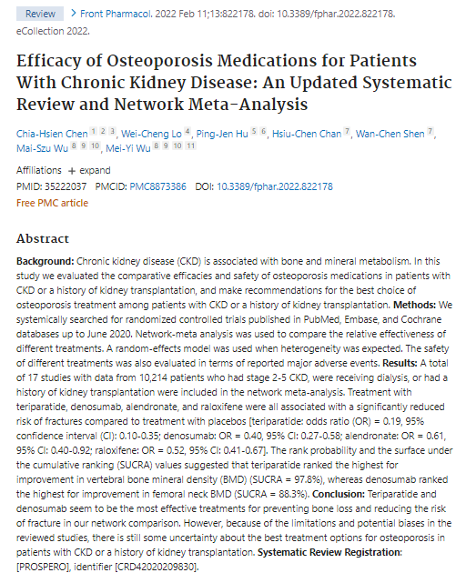
Teri - 81%
Deno -60%
Alendo -39%
Raloxi -33%

Slide 46
In the NCCN Clinical Practice Guidelines in Oncology (NCCN Guidelines®), denosumab is included as a treatment option to increase bone density in certain men with nonmetastatic prostate cancer.2

Slide 47
Bone Health and Bone-Targeted Therapies for Nonmetastatic Prostate Cancer: A Systematic Review and Meta-analysis
27 trials
men with nonmetastatic prostate cancer who were initiating or continuing androgen deprivation therapy (ADT).
Bisphosphonates were effective in increasing BMD, but no trial was sufficiently powered to detect reduction in fractures.
Denosumab improved BMD and reduced the incidence of new radiographic vertebral fractures in 1 high-quality trial.
Conclusion: Both bisphosphonates and denosumab improve BMD in men with nonmetastatic prostate cancer who are receiving ADT. Denosumab also reduces risk for radiographic vertebral fractures, based on 1 trial. More trials studying fracture outcomes are needed in this population.
Review Ann Intern Med. 2017 Sep 5;167(5):341-350.

Slide 48
In the NCCN Clinical Practice Guidelines in Oncology (NCCN Guidelines®), denosumab is included as a treatment option to increase bone density and reduce risk of fractures in postmenopausal women on aromatase inhibitor therapy.

Slide 49
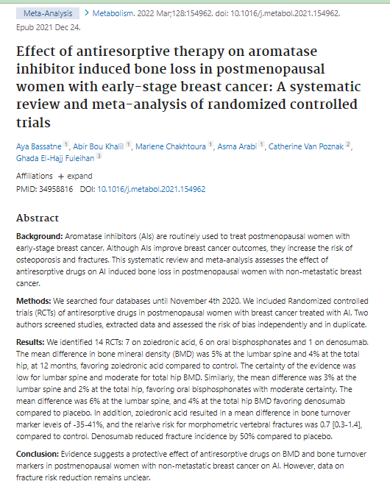
Bisphosphonate_ fracture risk : - 35-41%
Denosumab :- 50%

Slide 50
Guidelines

Slide 51
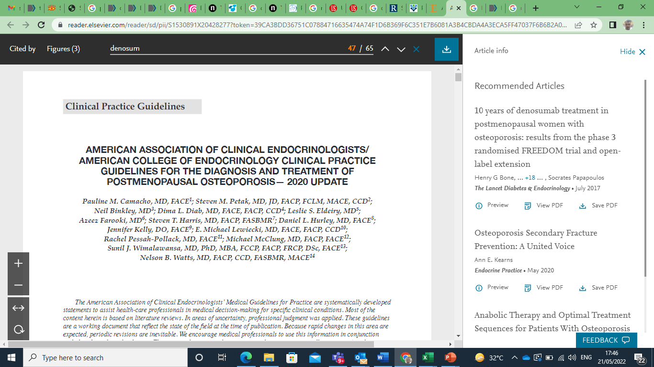
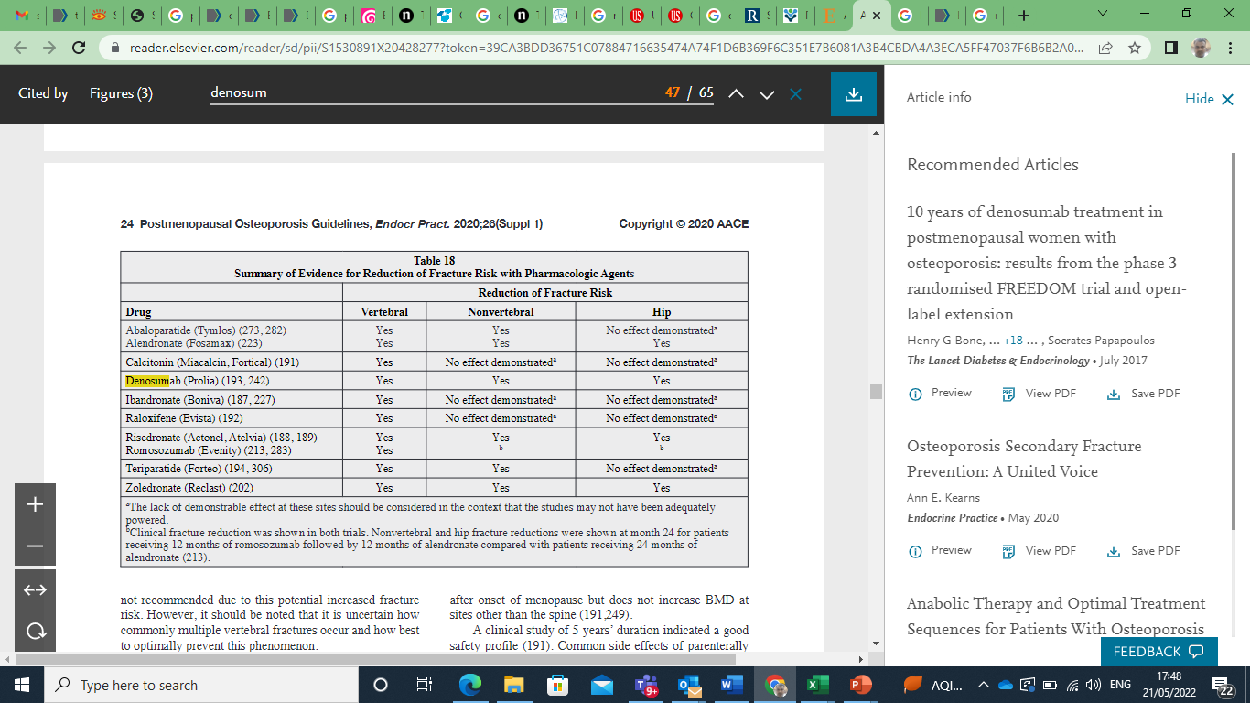

Slide 52
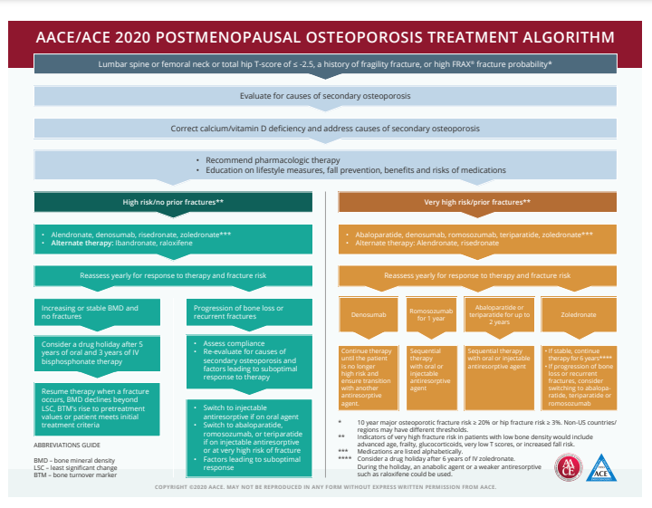

Slide 53
Key messages
Denosumab
binds to RANKL and inhibits it, inhibiting the formation of osteoclasts
this reaction protects the bone from resorption by mimicking the natural activity of OPG
SC every 6 month
Indication : Osteoporosis secondary to post menopause , ADT in prostate cancer , Aromatase inhibitor in BC. Men osteoporosis
Warning : Hypocalcemia
Renal impairment : No dose adjustment

Slide 54
Clinical overview
Denosumab vs Bisphosphonate
Meta-analysis (J Clin Endocrinol Metab, May 2019)
10 eligible trials including 5361 participants
24 months
Vs Bisph , 49% less risk of fracture
Teriparatide + Denosumab
DATA study (Lancet. 2013 )
Combined teriparatide and denosumab increased BMD more than either agent alone
Teriparatide to Denosumab
DATA switch study (Lancet 2015)
Postmenopausal osteoporotic women switching from teriparatide to denosumab, bone mineral density continued to increase, whereas switching from denosumab to teriparatide results in progressive or transient bone loss

Slide 55
Clinical overview
Denosumab vs Other therapies in Post menopause (J Clin Endocrinol Metab, May 2019, 104(5):1623–1630)
107 trials (193,987 postmenopausal women; mean age, 66 years
 | Hip fracture risk reduction | Non vertebral | Vertebral
Denosumab | -44% | -20% | -68%
Zoledronic acid | -40% | -21% | -62%
Romosozumab | -56% | -49% | - 67%
Teriparatide, abaloparatide, denosumab, romosozumab, and most bisphosphonates appear to have the highest efficacy
J Clin Endocrinol Metab, May 2019, 104(5):1623–1630

Slide 56
Clinical overview
FREEDOM Study

Slide 57
Clinical overview
Glucocorticoid induced (J Clin Endocrinol Metab. 2020 Jan 1;105(1):dgz023)
19 unique trials involving 4328 patients receiving GCs
Teriparatide (risk ratio [RR] 0.11, 95% confidence interval [CI] 0.03-0.47), denosumab (RR 0.21, 95% CI 0.09-0.49), and risedronate (RR 0.33, 95% CI 0.19-0.58) reduced the risk of GI vertebral fractures
In terms of clinical efficacy and safety, second-line teriparatide and denosumab pose a challenge to first-line oral bisphosphonates for prevention of GI fractures

Slide 58
Clinical overview
In RA (Front Immunol. 2022 Jan 5;12:799575)
10 studies with a total of 1758 patients
Denosumab treatment was associated with increased BMD and alleviated progression of joint destruction in RA patients, even when compared with bisphosphonates.
In CKD (Front Pharmacol. 2022 Feb 11;13:822178.)
17 studies with data from 10,214 patients
Significantly reduced risk of fractures compared to treatment with placebos [teriparatide: odds ratio (OR) = 0.19, 95% confidence interval (CI): 0.10-0.35; denosumab: OR = 0.40, 95% CI: 0.27-0.58; alendronate: OR = 0.61, 95% CI: 0.40-0.92; raloxifene: OR = 0.52, 95% CI: 0.41-0.67]

Slide 59
Clinical overview
In prostate cancer (Review Ann Intern Med. 2017 Sep 5;167(5):341-350)
27 trials
Nonmetastatic Prostate Cancer
Both bisphosphonates and denosumab improve BMD in men with nonmetastatic prostate cancer who are receiving ADT
Denosumab also reduces risk for radiographic vertebral fractures
In Breast cancer (Metabolism. 2022 Mar;128:154962)
14 RCTs
Bisphosphonate_ fracture risk : - 35-41%
Denosumab :- 50%

Slide 60
Guidelines
NCCN recommendation in
nonmetastatic prostate cancer
postmenopausal women on aromatase inhibitor therapy
American college of clinical endocrinologist in post menopausal osteoarthritis
Alendronate , Zoledronate , Romosozumab and Denosumab is recommend in Hip , Vertebral and Nonvertebral fractures
Denosumab considered as first line in both high risk and very high risk patients

